Slide 1
Functional Approach to write code
By Anastasiia Khudnytska

Slide 2
What is Functional Programming?
In computer science, functional programming is a programming paradigm or pattern (a style of building the structure and elements of computer programs)
Functional Programming treats computation as the evaluation of mathematical functions.
Functional Programming avoids changing-state and mutable data.
You could also say that Functional Programming was simply a bunch of functions that don’t allow outside scope nor mutation of objects. Rather than we mutate arrays by adding/removing inside the scope to achieve a solution like OOP does, functional is pure, straightforward and doesn’t mutate.

Slide 3
Why Functional Programming?
Its pure function, provides confidence of not changing things outside of its scope.
Its reduces the complexity, need not to worry about how it is doing it, focus will be only on what it is doing.
Ease of testing, because it does not depend on state of the application and result verification also will be easy.
It makes the code more readable.
Functional programming makes code easier to understand.

Slide 4
Pure functions
A pure function must satisfy both of the following properties:
Referential transparency: The function always gives the same return value for the same arguments. This means that the function cannot depend on any mutable state.
Side-effect free: The function cannot cause any side effects. Side effects may include I/O (e.g., writing to the console or a log file), modifying a mutable object, reassigning a variable, etc.
Math.random() -
Math.min(1,2) -
is not pure function because it always returns new value on each call.
is an example of pure function which always returns same value with same set of inputs

Slide 5
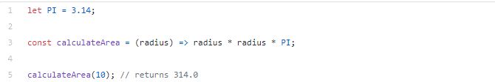
Pure functions
It returns the same result if given the same arguments
Imagine we want to implement a function that calculates the area of a circle. An impure function would receive radius as the parameter, and then calculate radius * radius * PI:
Why is this an impure function? Simply because it uses a global object that was not passed as a parameter to the function.
Now imagine some mathematicians argue that the PI value is actually 42and change the value of the global object.
Our impure function will now result in 10 * 10 * 42 = 4200. For the same parameter (radius = 10), we have a different result.

Slide 6
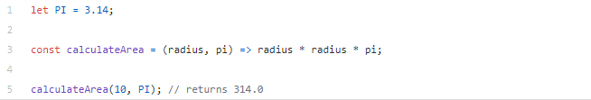
Pure functions
Now we’ll always pass the PI value as a parameter to the function. So now we are just accessing parameters passed to the function. No external object.
For the parameters radius = 10 & PI = 3.14, we will always have the same the result: 314.0
For the parameters radius = 10 & PI = 42, we will always have the same the result: 4200

Slide 7
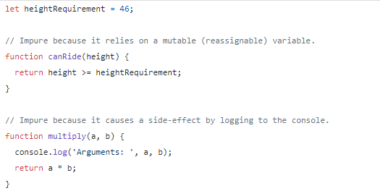
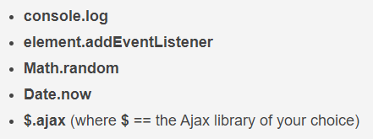
Pure functions
The following are examples of impure functions. The canRide function depends on the captured heightRequirement variable. Captured variables do not necessarily make a function impure, but mutable (or re-assignable) ones do. In this case it was declared using let, which means that it can be reassigned. The multiply function is impure because it causes a side-effect by logging to the console.
built-in functions in JavaScript that are impure:

Slide 8
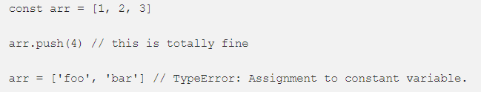
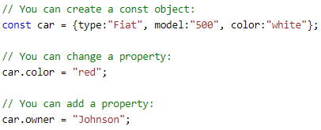
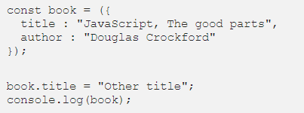
Prefer const
JavaScript has a const declaration, which is perfect for functional programming since we won’t be mutating any data.
If you are assigning a value to a variable, and you’re not going to be reassigning that value, const is the safest choice and communicates this intent.
const prevents the variable to be assigned to another value.
You should take advantage of the fact that while declaring an object with const doesn’t actually make it immutable (you can still change its properties, etc.), it does at least protect the instance from being reassigned.

Slide 9
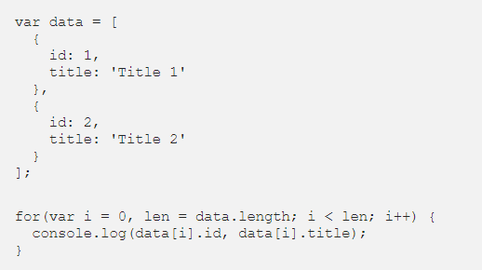

Avoid loop
Replacing loops with array methods
Modern languages have better ways to express iterative operations. JavaScript has many useful methods to transform and iterate over arrays
=

Slide 10
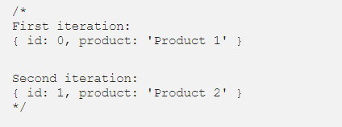
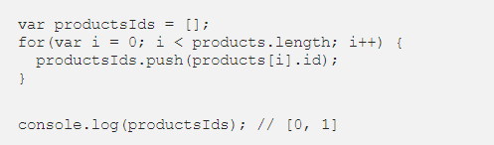

Avoid loop
loop
map() method
=

Slide 11
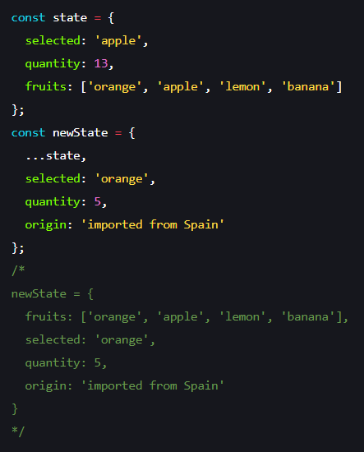
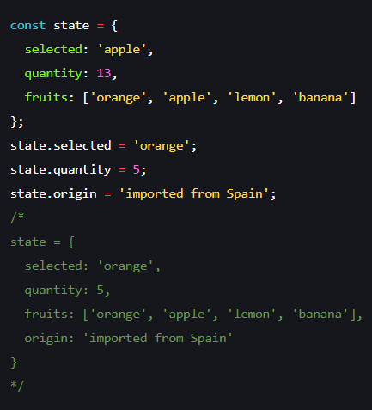
Working with objects as immutable
Modify and/or add property
Let’s say we want to change the selected fruit and set the new quantity. The standard way to do it is by mutating the object.
Again, we can leverage the spread operator to create a copy of the object with fields changed. The spread here is, similar to array, spreading the key-value pairs of the original object onto a new one. With the next two lines, we are overriding the values from the original object. The last line is creating a new field called ‘origin’.

Slide 12
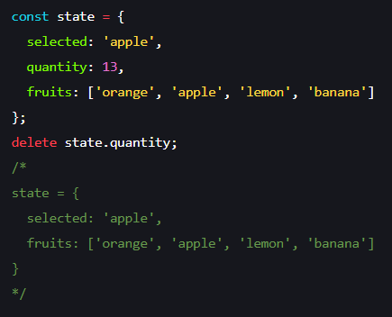
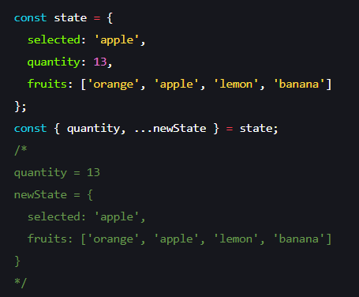
Working with objects as immutable
Remove a property
Removing a property in an immutable way requires a little trick provided by spread’s counterpart rest. Rest operator is written in the same way as spread - with .... However, the meaning, in this case, is not to spread all the fields, but rather remaining ones.
This technique is called destructuring assignment as we are unpacking the original state object.
To remove an object’s property in a mutable way, we will simply call delete:

Slide 13
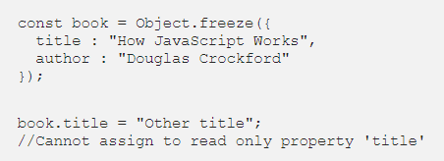
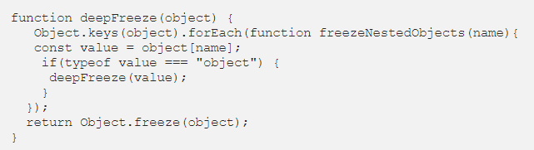
Freezing objects
To make objects immutable we need to freeze them.
Object.freeze() can be used to freeze objects. Properties can’t be added, deleted, or changed. The object becomes immutable.
Object.freeze() does a shallow freeze. The nested objects can be changed. For deep freeze we need to recursively freeze each property of type object. Here is how we can create a deepFreeze() implementation.

Slide 14


Working with array as immutable
Array has several mutable operations - push, pop, splice, shift, unshift, reverse and sort. Using them is usually causing side effects and bugs that are hard to track. That’s why it’s important to use an immutable way.
The array data structure is not immutable in JavaScript. In order to work with arrays as immutable data structures we need to use only the pure array methods and the spread operator. The pure array methods are the ones that create a new array when something changes.
Push
Push is an operation that adds a new item on top of the array.
The resulting array is a concatenation of the original array and the item. Let’s try to accomplish that in an immutable way:

Slide 15



Working with array as immutable
Unshift
Unshift is an operation similar to push. However, instead of adding the item at the end we will prepend the item at the beginning of the array.
Similarly, we will use a spread operation to achieve immutability, but with a slight modification:
Pop
Pop is an operation that removes the last item from the end of the array and returns it.
To remove the item in an immutable way we will use slice. Note that we are making a copy of the last item before this operation. If the copy is not needed we can skip the second line, of course.

Slide 16

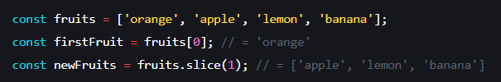

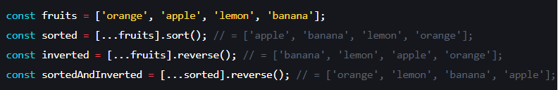
Working with array as immutable
Shift
Shift is an operation similar to pop, but instead of removing the item from the end we remove the item from the beginning of the array.
Our immutable solution is equivalent to the immutable pop. We don’t have to specify the end limit of slice operation if we want to take all items until the end.
Sort and reverse
Sort and reverse are operators that, respectively, sort and invert the array’s items order.
Both, sort and reverse, are mutable in nature. However, using spread, we can make a copy of the array so the mutation happens on the copy, instead of the original array.

Slide 17
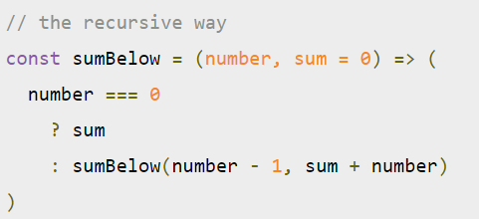
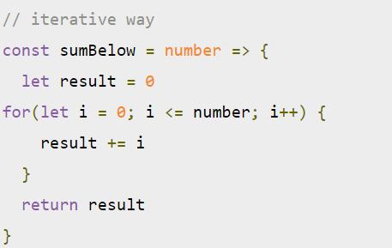
Recursion
First off, let’s do a quick review of what recursion looks like. For the purposes of this article, we’ll use a simple function called sumBelow — which takes a number and returns the sum of the number plus all numbers below it. For example, if I were to call sumBelow(5), I’d get 15 (5 + 4 + 3 + 2 + 1 = 15).
And in recursive fashion, the function would look like this:
If we were to write this function in a classic iterative fashion it would look something like this:
The “secret sauce” to recursion lies at the end of our sumBelow function, where we call sumBelow from within sumBelow. When we do this, the function continues to call itself until it produces a value. Then it trickles that value all the way back up to the first function call.

Slide 18

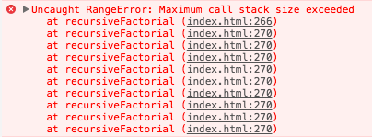
The problem with recursion
For example, let’s take out sumBelow function above. If we were to call it with a really big number, what do you think will happen?
The recursive function keeps adding entries to the JavaScript engines call stack until there’s no more room, and then we get an error.

Slide 19
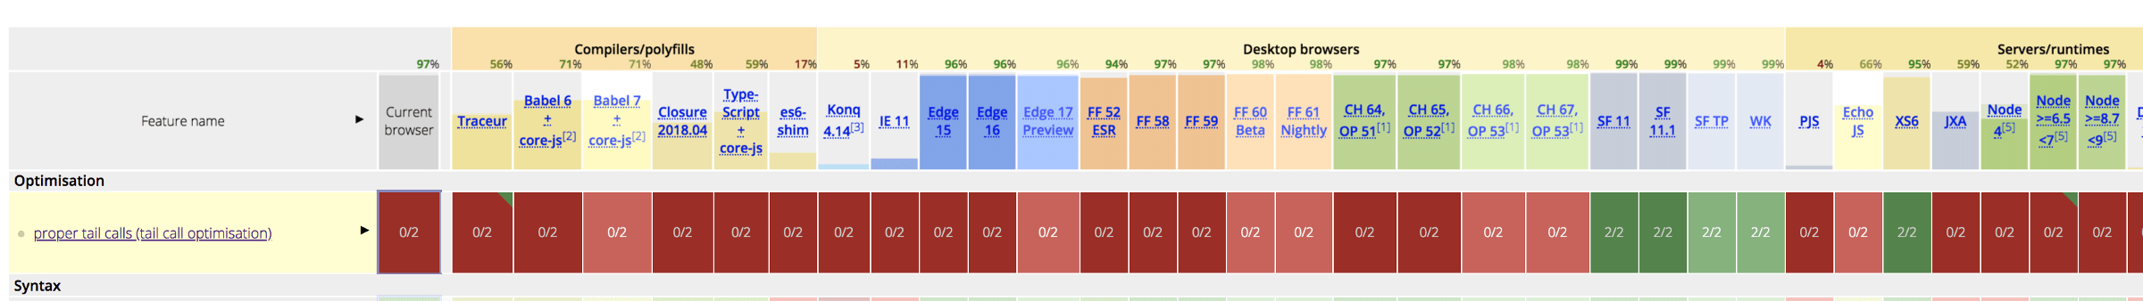
Optimizing with proper tail calls
One way to avoid blowing up the call stack is to use proper tail calls — these were added in the ES2015 spec. In order to use proper tail calls (PTC), a function satisfy the following conditions:
You must be in use strict mode.
The recursive function call must be in tail position — that is, it is the very last thing to be evaluated before the return statement.
The cool thing with PTC is that if you’re writing your recursive functions already with proper tail calls, you don’t have to change any code! For instance, our sumBelow function is already written with a proper tail call, so all we would have to do is run it in an environment that supports proper tail calls.
The catch is proper tail calls has spotty support at best.

Slide 20
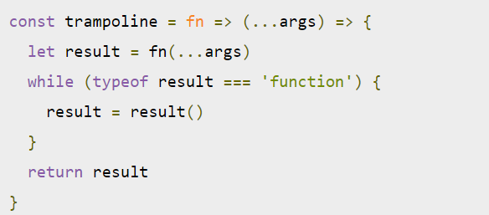
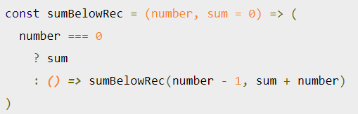
A simple, non-disruptive option: Trampolines
A trampoline function basically wraps our recursive function in a loop. Under the hood, it calls the recursive function piece by piece until it no longer produces recursive calls.
What’s happening under the hood of this trampoline function? It takes a function (fn) as its argument—this is the recursive function it is going to wrap—and returns a new function. We keep the loop running as long as fn returns another function. Once fn resolves into a value, we stop running the loop and return the value.
We have to slightly modify our recursive function in order to be used by the trampoline function. All we have to do is add an anonymous function to the recursive portion. That way it returns a function and can be managed by the while loop of the trampoline function.

Slide 21
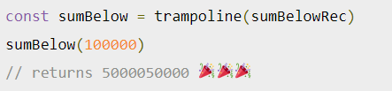
A simple, non-disruptive option: Trampolines
Since our recursive function now returns a new function without actually calling itself yet, we get to control when the next call to sumBelowRecursive happens inside our trampoline function. This allows us to continue calling sumBelowRec without blowing up the call stack.
The last step is to wrap sumBelowRec inside of our trampoline function.

Slide 22
Reference:
https://blog.logrocket.com/using-trampolines-to-manage-large-recursive-loops-in-javascript-d8c9db095ae3/
https://opensource.com/article/17/6/functional-javascript
https://habr.com/ru/post/464915/

Slide 23


